Slide 1
ASSISTIVE BRAINSTORMING FOR IDEA VALIDATION
Gautamdev Chowdary
Rounak Sengupta

Slide 2
Problem Statement
There’s research that states when two humans discuss, it generally has about 40 percent factual errors.
Analysing large chunks of factual statements and coming up with valid arguments can be more efficient with a bot.
This could decrease the dependence of humans on other humans while analysing facts and coming up with new ideas.

Slide 3
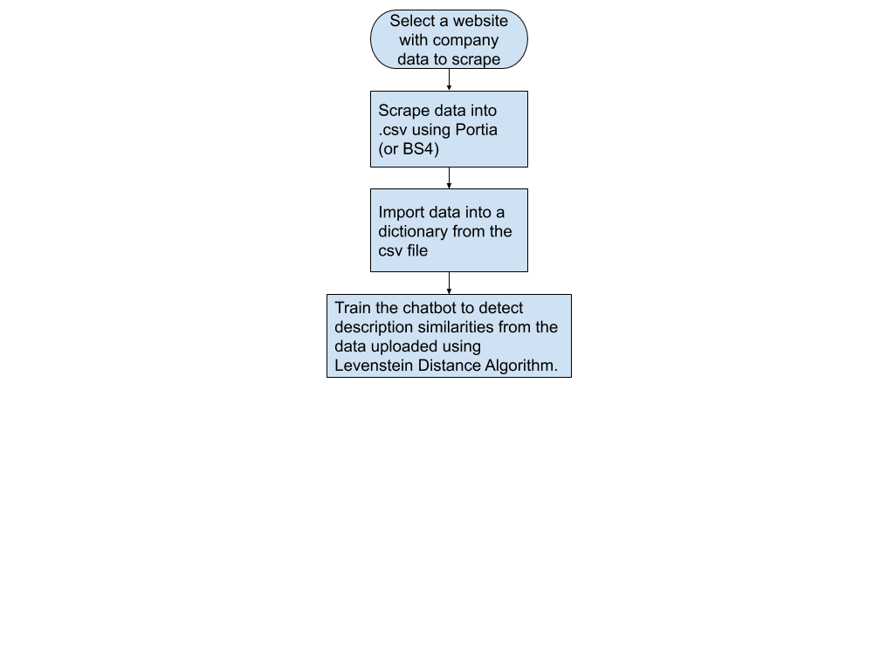
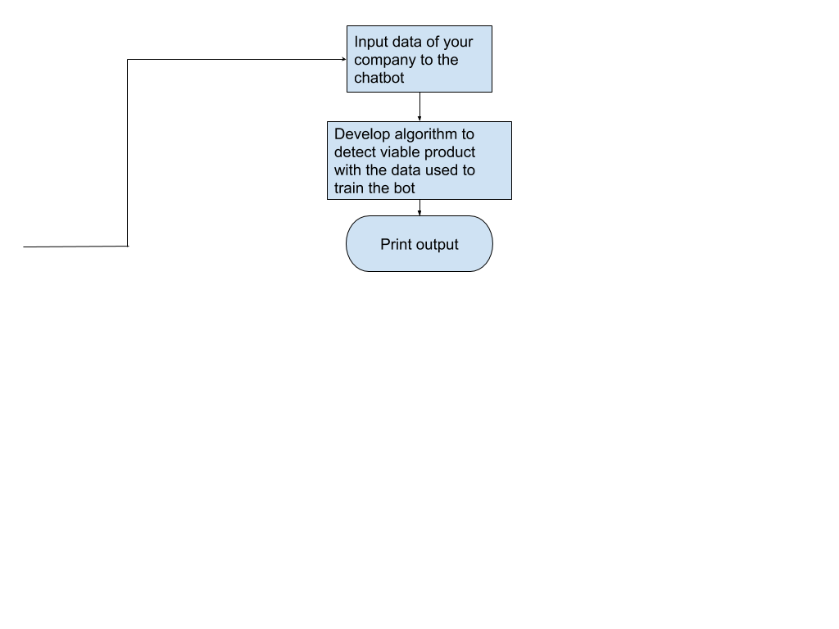
HOW TO APPROACH THE PROBLEM

Slide 4
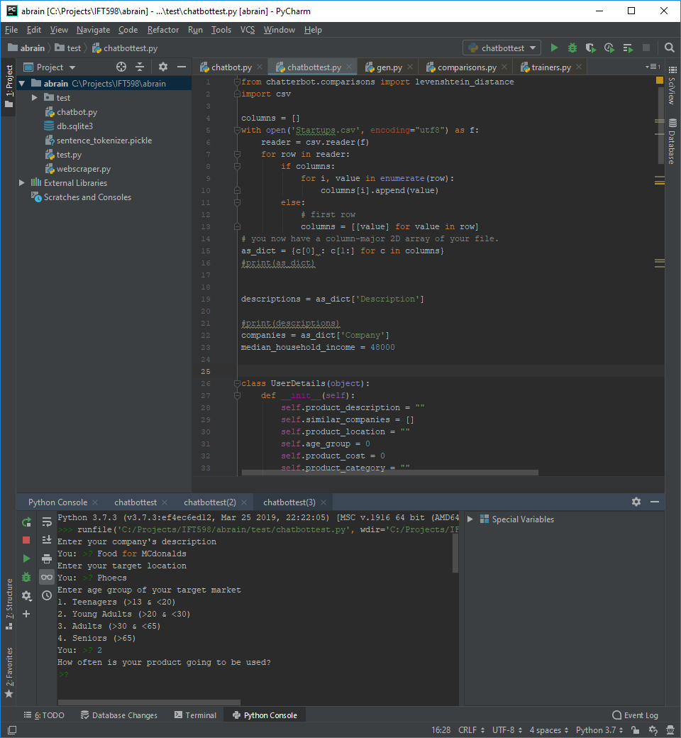
Screenshots (1/4)

Slide 5
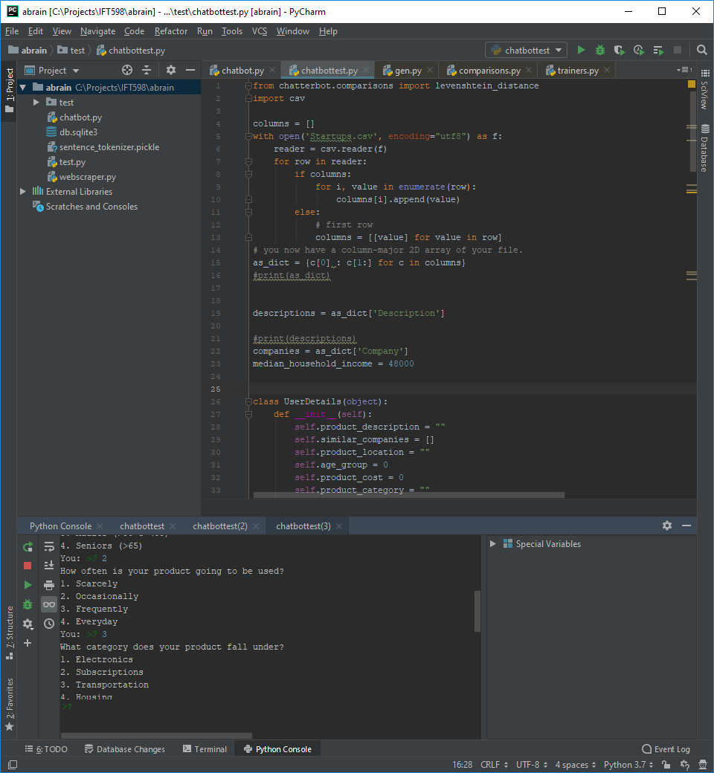
Screenshots(2/4)

Slide 6
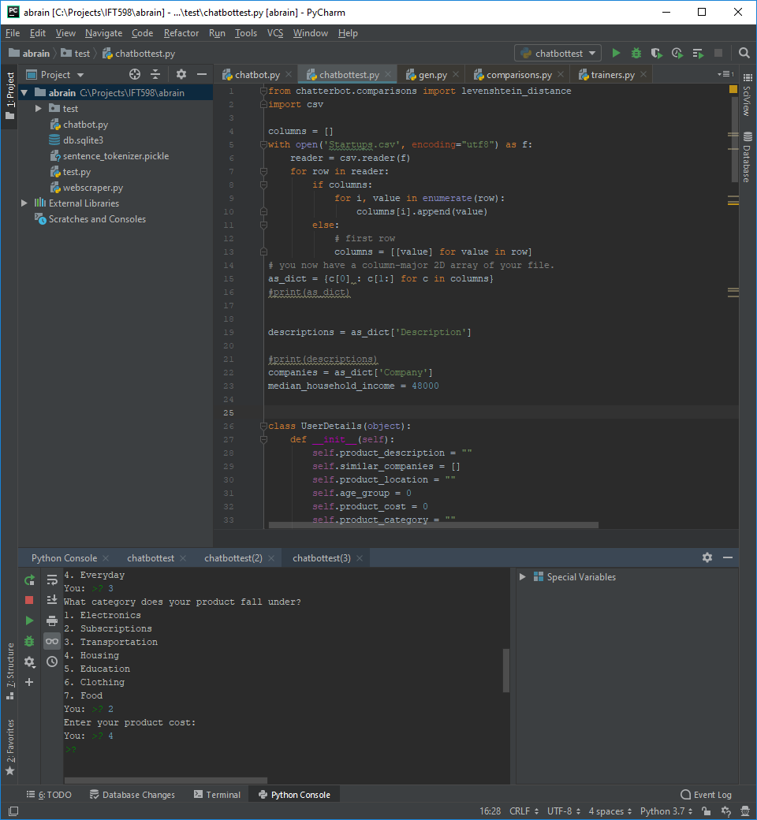
Screenshots(3/4)

Slide 7

Screenshots(4/4)

Slide 8
Challenges
Collecting data of various companies from various sources (craft.co, CrunchBase) by web scraping.
Coming up with various situations and respective questions to be asked.
Lack of documentation for the Machine Learning Chat Bot (Chatterbot)
Time Constraints

Slide 9
Conclusion
Useful to many business owners who are inexperienced in the daily decisions required to run a company
can help them constructively think about ideas and implementations in marketing, finance and resource management
Future uses include helping students brainstorm for essays and project ideas

